Slide 1

AI Engineer Agentic Track
The Complete
Agent & MCP
Course
Week 6
Day 1

Slide 2
Week 6: MCP
Agentic
Architecture
and MCP
Building
MCP Server
Context
Engineering
with MCP
Project 8: AI
Equity Traders
Project 8: AI
Equity Traders
In Action
Week 5: Agent Frameworks
Google ADK
and A2A
Strands and
Pydantic AI
MAF and
Agno
Mastra
Project 7:
Agent Loop
Week 4: LangGraph
LangChain
Core
LangGraph
LangChain
create_agent
Deep Agents
Project 6:
Sidekick
Week 3: CrewAI
Understand
Crew AI
Concepts
Build a Crew
Agent
Project 4: Stock
Picker
Project 5:
Developer
Agent
Project 5:
Engineering
Team
Week 2: OpenAI Agents SDK
Understand
OpenAI Agents
SDK concepts
Project 2: an
SDR
Tools vs Agents
Guardrails
Project 3: Deep
Research
Project 3: Deep
Research app
Week 1: Foundations
Make an
Agentic
Workflow
Agents and
Agentic
Patterns
Orchestrating
LLMs
Autonomy and
Tools
Project 1:
Your personal
career agent

Slide 3

BUSTED!!
I know you're impatient for MCP…
Week 1 - Native use of APIs and Tools
Week 2 - OpenAI Agents SDK

Slide 4




An Agent is..
An LLM
with Tools
In a loop
To achieve a goal
Or..
An LLM
+
A Harness

Slide 5
Remember this slide?
Agent Frameworks
CrewAI
LangGraph / LangChain
OpenAI Agents SDK
Google
ADK
AWS Strands Agents
No framework

Slide 6
The Spectrum of Agent Frameworks
From a raw model call to a full agent harness
LIGHTWEIGHT / LOW-LEVEL
BATTERIES INCLUDED / HIGH LEVEL
Direct LLM calls
Strands Agents
Claude Agent SDK
LangGraph
LangChain Deep Agents
LangChain Core Components
CrewAI
Most general-purpose frameworks land here
OpenAI Agents SDK
LangChain create_agent
Google ADK
Agno
Mastra
Pydantic AI

Slide 7
Claude Agent SDK
An SDK to programmatically drive Claude Code
query()
“Build AI agents that autonomously read files, run commands, search the web, edit code, and more. The Agent SDK gives you the same tools, agent loop, and context management that power Claude Code, programmable in Python and TypeScript.”
“The Agent SDK includes built-in tools for reading files, running commands, and editing code, so your agent can start working immediately.”
This is the least similar to an Agent Framework
in most cases you’re likely to use Claude Code directly

Slide 8

Finally! The Model Context Protocol!

Slide 9
MCP
What it's not
A framework for building agents
A fundamental change to how agents work
A way to code agents
What it is
A protocol - a standard
A simple way to integrate tools, resources, prompts
"A USB-C port for AI applications"

Slide 10
MCP
Reasons not to be excited
It’s just a standard, it’s not tools themselves
LangChain already has a big Tools ecosystem
You can already make any function into a Tool
Reasons to be excited
Makes it frictionless to integrate
Huge ecosystem
Agreed standards are important

Slide 11
MCP Core Concepts
The Three Components:
Host is an LLM app like Claude or our Agentic Platform
MCP Client lives inside Host and connects 1:1 to MCP Server
MCP Server provides tools, context and prompts
Example:
Fetch is an MCP Server that gets a webpage and returns Markdown
You can configure Claude Desktop (the host) to run an MCP Client that then
launches the Fetch MCP Server on your computer
Agent Frameworks take care of creating the MCP Client for you - you tell it which server to attach to

Slide 12
Architecture
Your computer
Remote server
Host
MCP
Client
MCP
Client
MCP
Client
MCP
Server
MCP
Server
MCP
Server
1. List Tools 2. Call Tool

Slide 13
Architecture
Your computer
Remote server
Host
MCP
Client
MCP
Client
MCP
Client
MCP
Server
Remote server
MCP
Server
MCP
Server
API
1. List Tools 2. Call Tool

Slide 14
MCP Servers most often run on your box
Download open-source MCP Servers, run them locally
Your computer
Remote server
Host
MCP
Client
MCP
Client
MCP
Client
MCP
Server
Remote server
MCP
Server
MCP
Server
API
1. List Tools 2. Call Tool

Slide 15
Two "Transport" mechanisms
Stdio spawns a process and communicates via standard input/output
Your computer
Remote server
Host
MCP
Client
MCP
Client
MCP
Client
MCP
Server
Stdio
Stdio
Remote server
MCP
Server
MCP
Server
API
1. List Tools 2. Call Tool

Slide 16
Two "Transport" mechanisms
..while Streamable HTTP uses HTTP (replaces the older SSE)
Your computer
Remote server
Host
Streamable HTTP
MCP
Client
MCP
Client
MCP
Client
MCP
Server
Stdio
Stdio
Remote server
MCP
Server
MCP
Server
API
1. List Tools 2. Call Tool

Slide 17
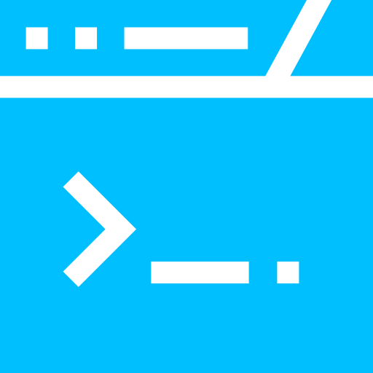

Connecting to MCP servers
A server is just a set of parameters
STDIO a local process to spawn
fetch
{"command": "uvx", "args": ["mcp-server-fetch"]}
playwright
{"command": "npx", "args": ["@playwright/mcp@latest"]}
Streamable HTTP a remote URL
context7
{"url": "https://mcp.context7.com/mcp", "timeout": 60}

Slide 18
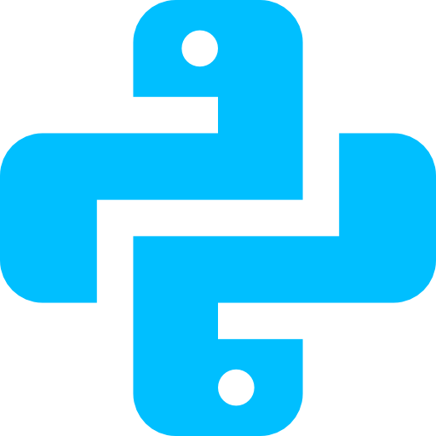
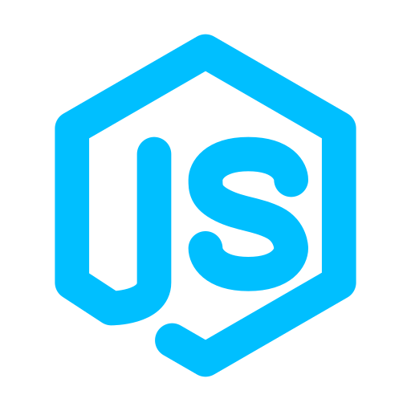
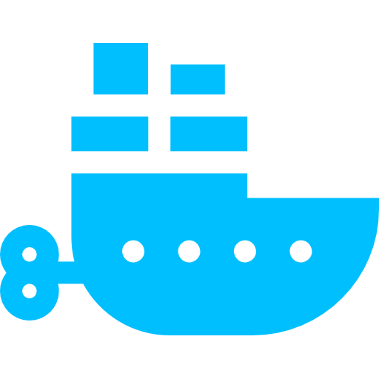
Spawning a local server
The command tells the client how to launch it
uvx for Python MCP servers
npx for Node and JavaScript servers
docker for servers packaged as a container

Slide 19
Week 6: MCP
Agentic
Architecture
and MCP
Building
MCP Server
Context
Engineering
with MCP
Project 8: AI
Equity Traders
Project 8: AI
Equity Traders
In Action
Week 5: Agent Frameworks
Google ADK
and A2A
Strands and
Pydantic AI
MAF and
Agno
Mastra
Project 7:
Agent Loop
Week 4: LangGraph
LangChain
Core
LangGraph
LangChain
create_agent
Deep Agents
Project 6:
Sidekick
Week 3: CrewAI
Understand
Crew AI
Concepts
Build a Crew
Agent
Project 4: Stock
Picker
Project 5:
Developer
Agent
Project 5:
Engineering
Team
Week 2: OpenAI Agents SDK
Understand
OpenAI Agents
SDK concepts
Project 2: an
SDR
Tools vs Agents
Guardrails
Project 3: Deep
Research
Project 3: Deep
Research app
Week 1: Foundations
Make an
Agentic
Workflow
Agents and
Agentic
Patterns
Orchestrating
LLMs
Autonomy and
Tools
Project 1:
Your personal
career agent

Slide 20

AI Engineer Agentic Track
The Complete
Agent & MCP
Course
87%
Complete

